Slide 1
INTRODUCTION
The National Joint Negotiating Funeral Committee was tasked with the following;
To produce a time framed roadmap towards finalization of the Funeral Assurance Policy.
To come up with the Committee’s Terms of References in line with Property Ownership Committee’s Terms of References.
To engage established funeral assurance companies for possible partnerships.

Slide 2
FUNERAL ASSURANCE POLICY ROADMAP

Slide 3
Activities and Timelines towards Public Service Funeral Assurance Policy
3rd Quarter 2025
31 July 2025
Funeral Assurance Policy Launch and awareness campaigns
End of 2nd Quarter 2025
Submission of the Final Concept Note to Commission for approval
10 June 2025
Presentation of Final Concept Note to NJNC for adoption
29 April 2025
Final Concept Note Development
15 April 2025
Resource Mobilisation: Submission to Treasury
01 April 2025
Finalisation of draft concept note for submission to Treasury
Stakeholder Engagement:
•Presentation during Consultative meetings with worker’s representatives

Slide 4
NATIONAL JOINT NEGOTIATING FUNERAL COMMITTEE TERMS OF REFERENCE

Slide 5
1.0 DEFINITION OF TERMS
Committee refers to the National Joint Negotiating Funeral Committee.
Members refers to individuals who form the Committee.
NJNC refers to National Joint Negotiating Council.
IPEC refers to Insurance and Pensions Commission.

Slide 6
2.0 PURPOSE
The purpose of the Committee is to assist the National Joint Negotiating Council Consultative Committee in fulfilling its obligations and responsibilities to provide members of the Public Service with a dignified burial in the event of their death or the death of their loved ones, as part of non-monetary benefits.

Slide 7
3.0 MEMBERS OF THE NATIONAL JOINT NEGOTIATING FUNERAL COMMITTEE
Name of the Member | Organisation | Membership
1. Mrs. V. Takototsa | Public Service Commission | Substantive (Chairperson)
2. Mr. C. Chinosengwa | Zimbabwe Confederation of Public Service Trade Unions | Substantive (Co- Chairperson)
3. Ms. O Manwa | Zimbabwe Confederation of Public Service Trade Unions | Substantive
4. Ms. L. Mukamba | Zimbabwe Confederation of Public Service Trade Unions | Substantive
5. Mr. B. Muruko | Zimbabwe Confederation of Public Service Trade Unions | Substantive
6. L. Mapatsa | Zimbabwe Confederation of Public Service Trade Unions | Substantive

Slide 8
CNT.... MEMBERS OF THE NATIONAL JOINT NEGOTIATING FUNERAL COMMITTEE
Name of the Member | Organisation | Membership
7. Mr. C. Mubwandarikwa | Zimbabwe Confederation of Public Service Trade Unions | Alternate
8. Mr. Z. Zhou | Zimbabwe Confederation of Public Service Trade Unions | Alternate
9. Ms. J. Rundogo | Zimbabwe Confederation of Public Service Trade Unions | Alternate
10. Mr. T. Chigayo | Public Service Commission | Alternate
11. Ms. B. M. Baradza | Public Service Commission | Substantive
12. Ms. C. Chigoronge | Public Service Commission | Substantive
13. Mr. N. Makaya | Public Service Commission | Substantive
14. Ms. P. Manyowa | Public Service Commission | Alternate
15. Ms. N. Chindara | Public Service Commission | Alternate
16. Mr. T. Chigayo | Public Service Commission | Alternate

Slide 9
4.0 ACCOUNTABILITY
The Committee will report to the National Joint Negotiating Council Consultative Committee through minutes of its meetings, progress reports and presentations where appropriate.

Slide 10
5.0 SCHEDULE OF MEETINGS AND QUORUM
The committee is entitled to invite non-members to its meetings.
Committee meetings shall be convened least quarterly and at any other time that the Chairperson may request.
Meetings agendas shall be prepared and distributed at least 7 days prior to the scheduled meeting with relevant reports with sufficient background information to allow the Committee members adequate time to prepare for the meeting.
In the event of Special Meetings, the Committee packs shall be circulated at least three (3) days before such meeting unless waiver has been granted by Chairperson for the said pack to be distributed within a shorter period of less than three (3) days.

Slide 11
CONT...
5.0 SCHEDULE OF MEETINGS AND QUORUM
The quorum shall only be duly constituted when 50% of the Funeral Committee members are duly represented inclusive of representatives from the workers
The Committee take decisions by consensus. In the event of a deadlock, the Chairperson
shall refer the issues to the NJNC.
g. Secretariat Services shall be provided by the Public Service
Commission
The Chairperson shall be from the Public Service Commission.
The Vice Chairperson shall be from the Workers representatives.

Slide 12
6.0 OBJECTIVES OF THE COMMITTEE
The broad objectives of the Committee are to:
To undertake research on ways to reduce financial burden to civil servants in the event of death as assigned by the National Joint Negotiating Council Consultative Committee.
b) Keep track on implementation decision of the National Joint Negotiating Council
Consultative Committee on Funeral Assurance Policy.
Propose and recommend policy changes in relation to IPEC Funeral Assurance Policy Regulations and related policies.
d) To propose and recommend possible synergies or partnerships with established funeral
assurance companies when there is need.
e) Execute any work as delegated by the National Joint Negotiating Council Consultative
Committee.

Slide 13
7.0 INDEPENDENT ADVICE
The committee may at any time, engage independent specialist consultants to assist with information and or documentation to enable decision making.

Slide 14
8.0 RELATIONSHIPS WITH OTHER NATIONAL JOINT NEGOTIATING COMMITTEES
The Committee shall recognize the existence of other committees of National Joint Negotiating Council Consultative Committee and shall seek guidance, as appropriate, on any issues of potential duplication of effort.

Slide 15
9.0 REVIEW AND APPROVAL
The terms of reference are subject to annual review by National Joint Negotiating Council Consultative Committee. It is the responsibility of the Chairperson of the Committee to ensure that the review is undertaken.

Slide 16
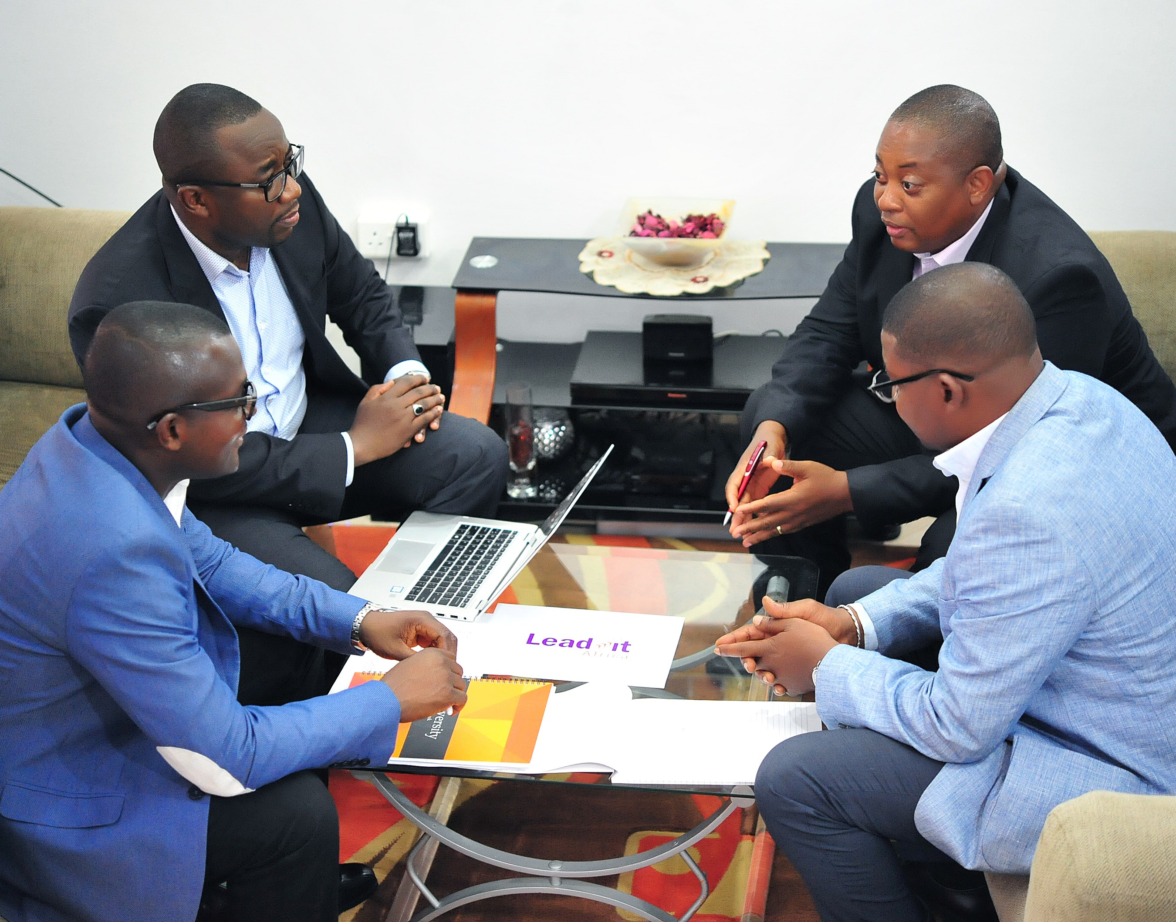
Engagement of Established Funeral Assurance Companies for Potential Partnerships

Slide 17
ENGAGEMENT OF ESTABLISHED FUNERAL ASSURANCE COMPANIES
The Committee invited Old Mutual Life Assurance, First Mutual Holdings and Moonlight Funeral Assurance to attend the first quarter consultative workshop and make presentations on their group product structures.
This will enable the NJNC to be in a position to make an informed decision in the event that the Public Service Funeral Assurance policy is to be established through synergies since already established organisations have technical expertise in funeral assurance.

Slide 18
THANK YOU

