Slide 1
Labour Migration & Inclusion of Migrants in the Public Service Sector
Presented to the Public Service Commission
25/06/25 | Mutare | Collen Mawasa

Slide 2
Overview
Introduction to labour migration
Importance for Zimbabwe
Legal and policy context
Opportunities for the public sector
Strategic recommendations

Slide 3






Migration Overview: Scale and Challenges
164 million international migrant workers
25 million victims of forced labour
– half are trapped due to debt
1 in 7 people are migrants
281 million international migrants
Women represent a higher proportion of victims – but men are victims too
42 per cent
of migrants are women
USD 717 billion per year in remittances

Slide 4
What Is Labour Migration?
Movement of people for employment across borders
Skilled, semi-skilled, unskilled, returnees
Zimbabwe is both a source and receiving country

Slide 5
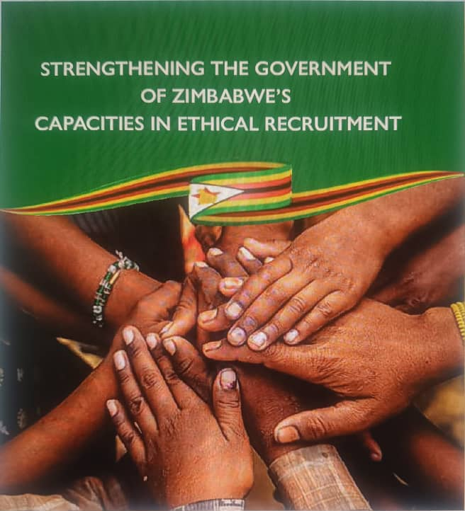
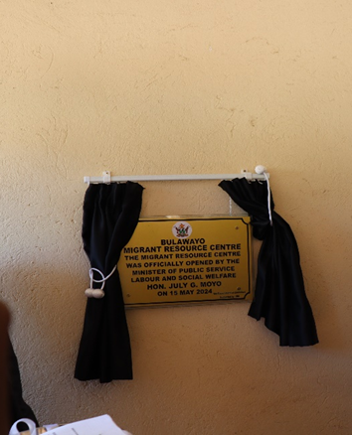
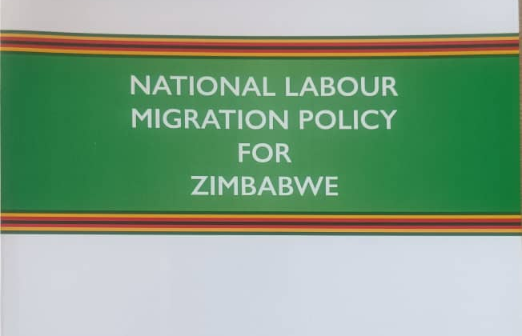
IOM Zimbabwe work in Labour Migration

Slide 6
Labour Migration in Zimbabwe
3+ million Zimbabweans in diaspora
Increasing return migration
Part of regional migration corridors (COMESA, SADC)

Slide 7
Legal and Institutional Frameworks
National Migration Policy (2023)
Labour Act [Chapter 28:01]
Labour Migration Policy
Constitution of Zimbabwe
Aligned with AU & GCM protocols

Slide 8
Why Include Migrants in Public Service?
Tap diaspora skills and experience
Foster inclusion and prevent marginalisation
Fill critical skills gaps
Promote governance legitimacy through diversity

Slide 9
Types of Migrants to Consider
Returnees from SA, UK, etc.
Refugees with legal status
Spouses and children of foreign nationals
Skilled diaspora professionals

Slide 10
Current Barriers to Inclusion
Foreign qualifications not recognised
No targeted recruitment
Bureaucratic regularisation
Bias and perception issues

Slide 11
Good Practices (Global Examples)
Rwanda: Diaspora in civil service
Philippines: Labour migration strategy
South Africa: Critical skills visas
Germany: Integration policies

Slide 12
Institutional Entry Points
PSC Human Capital Strategy
Pilot in MoHCC, MoPSE, MoICT
Diaspora desks in ministries
Skills Return & Internship Programme

Slide 13
Key Policy Recommendations
Update recruitment policy
Fast-track credential recognition
Pilot quotas in critical sectors
Partner with IOM, AU, etc.

Slide 14
Capacity Building Needs
Train HR & PSC units
1
Develop inclusive manuals
2
Establish support mechanisms
3

Slide 15
Monitoring & Evaluation
Track % of migrant applications
Time to credentialing
Retention after 2 years
Report to PSC & Parliament

Slide 16
Benefits to Zimbabwe
Skills transfer
Social cohesion
Vision 2030 aligned
Regional migration leadership

Slide 17

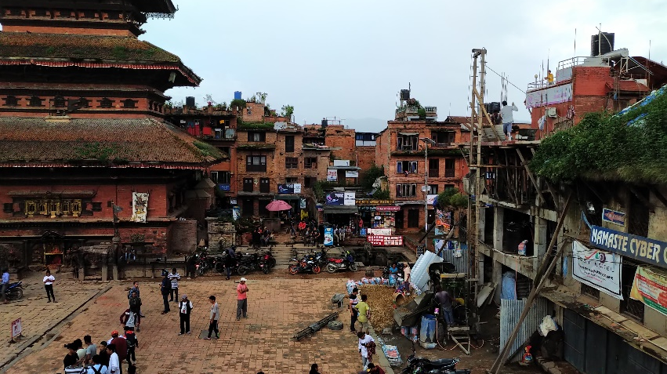
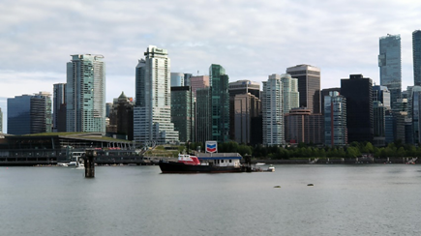
WELL MANAGED MIGRATION BENEFITS ALL
Workers
Countries of Origin
Countries of Destination
Provides an opportunity to raise income levels, gain skills and improve living conditions for families and communities
Reduces stress of national underemployment, and contributes to development through remittances, transfer of skills and new business networks
Helps fill critical labour shortages, especially within the context of ageing populations and changing labour demographics
But sadly, migrants can be vulnerable to exploitation

Slide 18
Conclusion
“Migrants are not outsiders to development—they are agents of progress.”
Inclusion is strategic
Policy & programme shifts needed
PSC must lead the change

