Slide 1
PRESENTATION ON OCCUPATIONAL SAFETY AND HEALTH IN THE PUBLIC SERVICE.
PRESENTER: MS. I. MATARE

Slide 2
OCCUPATIONAL SAFETY AND HEALTH IN THE PUBLIC SERVICE
The 2024 Public Service second quarter Consultative Workshop initiated the mainstreaming of Occupational Safety and Health in the Public Service.
From the workshop, it was resolved to establish a Joint OSH Committee as the first step towards the introduction of OSH in the Public Service. The Joint Committee consists of Government MDAs, Public Service Workers’ representatives and NSSA.
The purpose of the Joint OSH Committee is to come up with an OSH Policy for the Public Service and a comprehensive framework for promoting OSH for Civil Servants.

Slide 3
ESTABLISHMENT OF THE JOINT COMMITTEE
The Joint Occupational Safety and Health Committee was established in January 2025.
The committee consists of twelve (12) members: two representatives from Public Service Commission, four representatives from the Workers’ representatives, one representative from National Social Security Authority as the Technical Advisor.
The following Ministries are incorporated into the Committee: Ministry of Primary and Secondary Education, Ministry of Public Service, Labour and Social Welfare, Ministry of Mines and Mining Development, Ministry of Local Government and Public Works and Ministry of Lands, Agriculture, Fisheries, Water and Rural Development.

Slide 4
MEETINGS CONVENED
Two Joint Committee meetings were held during the period from February to March 2025.
The Committee members appointed the Chairperson and Vice for the Committee.
The Chairperson for the Committee is a representative from the Public Service Commission and the Vice Chairperson is a Workers’ representative.
The Committee drafted Terms of Reference, Roadmap, and Workplan for 2025 which will be presented here for adoption by NJNC.

Slide 5
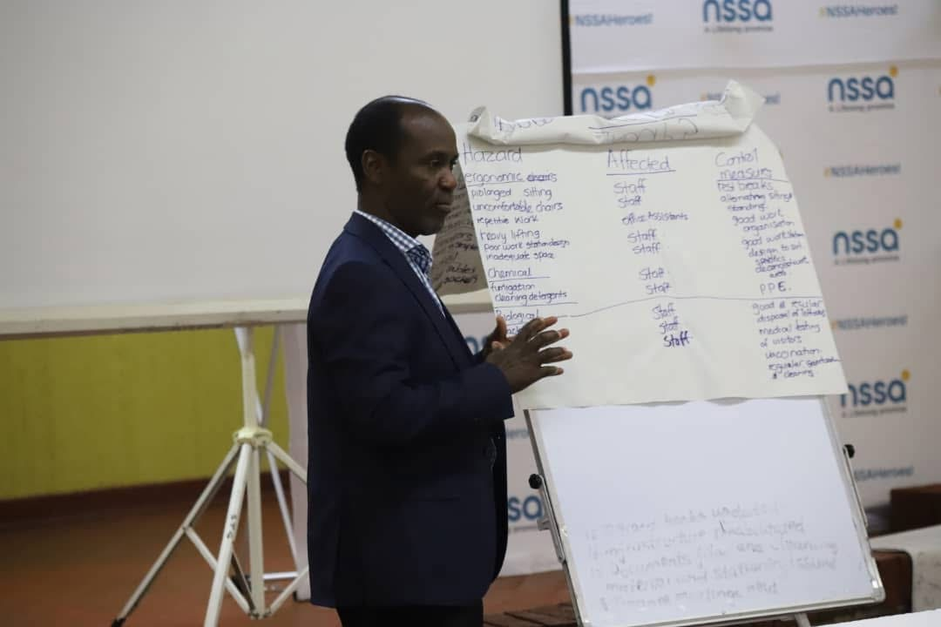
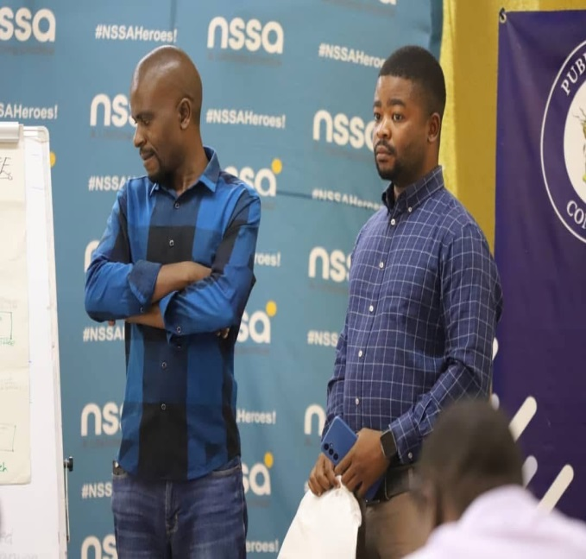
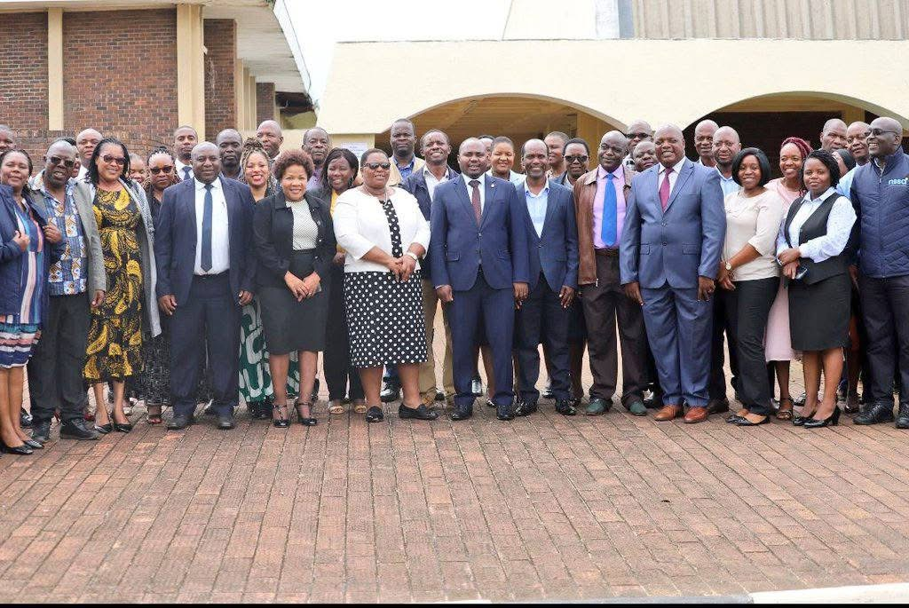
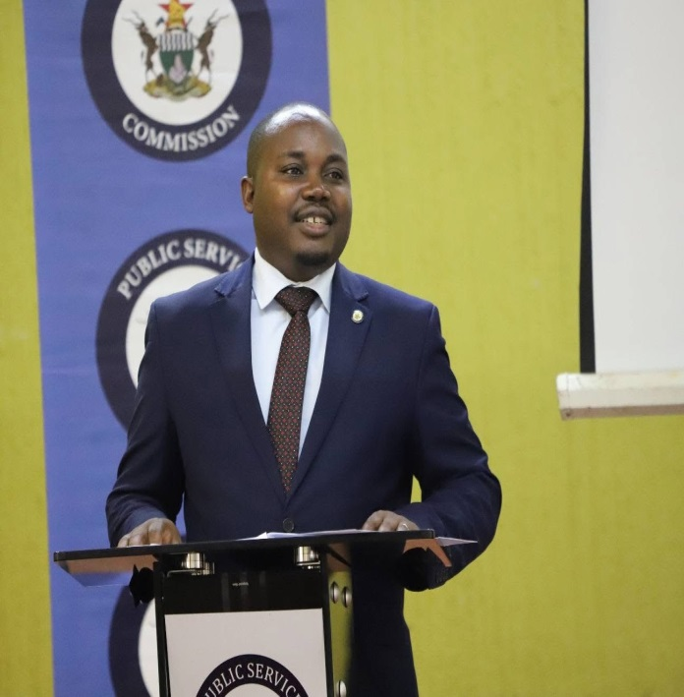
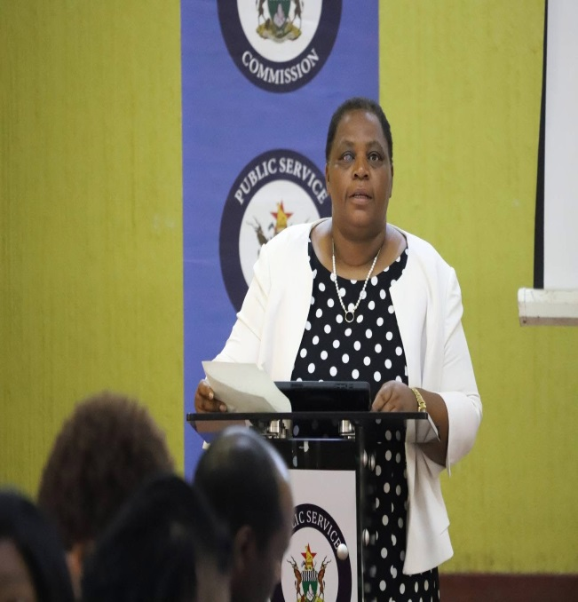
GWERU CAPACITY BUILDING WORKSHOP
Notes:
Some of the participants at the capacity building workshop on OSH at Senga Training Academy in Gweru from the 25th – 27th of February 2025 with NSSA.

Slide 6
GWERU CAPACITY BUILDING WORKSHOP
2024 Fourth quarter Consultative workshop in Nyanga resolved to capacitate Public Service Workers representatives and relevant stakeholders on OSH.
The purpose of the capacity-building workshop was to equip participants with knowledge and skills needed to contribute effectively to building a critical mass of knowledgeable individuals, driving the development of the policy and legal framework for mainstreaming OSH in the Public Service.
The capacity building workshop was held in Gweru from the 25th – 27th of February 2025 and the facilitators were experts from NSSA.
The three-day workshop developed an implementation matrix of resolutions to be implemented this year. However, the resolutions should be adopted by NJNC before implementation.

Slide 7
KEY TAKEAWAYS AND INSIGHTS
It was resolved to expedite the Public Service OSH Bill and to develop the OSH policy for the Public Service.
Public Service Commission and MDAs to conduct hazard identifications, risk assessments and mitigations in order to maintain safety and health environment for Civil Servants, ensuring compliance with Occupational Safety and Health (OSH) standards.
OSH matters within the Public Service has to be prioritized and sanctions for acts of omission and commission related to OSH will be enforced.
Awareness programs and refresher courses will be extended to Public Sector workers to ensure that everyone becomes an ambassador for safety and health.

Slide 8
THANK YOU

