Slide 1




Public
PUBLIC SERVICE COMMISSION
GROUP FUNERAL SERVICES PROPOSAL
DO GREAT THINGS EVERY DAY

Slide 2








OVERVIEW OF GROUP FUNERAL PROPOSITION
Public
In 2021 Old Mutual launched an end-to-end funeral business providing cremation, burial, mortuary, chapel, ambulance and funeral services to individuals, corporates and affinity groups.
Key Policy Highlights for Group Funeral Proposal:
Free cover for biological, step or legally adopted children (up to 23 years of age)
No waiting period for accidental deaths
No waiting period for those switching from other service providers, provided their policies were in force for at least 12 months
Discounted rates for staff members, parents and in-laws
No limit on the age of elderly dependants added to Policy
Option for cremation service at claim stage
Optional riders such as additional cash, tombstone, and memorial service
We have seven full fledged 24/7 parlors and 54 service points (CABS) nationwide.

Slide 3
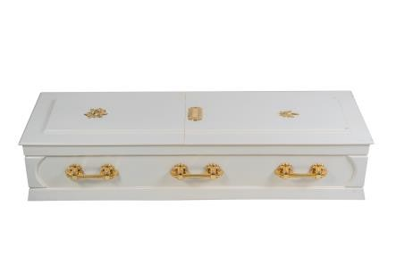
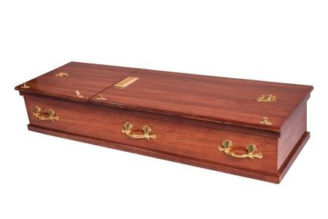

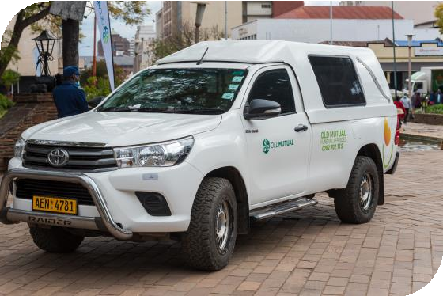
LITE PACKAGE
Public
CASKET:
BASIC / FLAT-LID
GROCERY BENEFIT
$100
HEARSE:
TOYOTA HILUX
PREMIUM PER MEMBER (WITHOUT BUS) PREMIUM PER MEMBER (WITH BUS)
PREMIUM PER PARENT (WITHOUT BUS) PREMIUM PER PARENT (WITH BUS)
$1.00
$1.89$1.21
$2.31

Slide 4
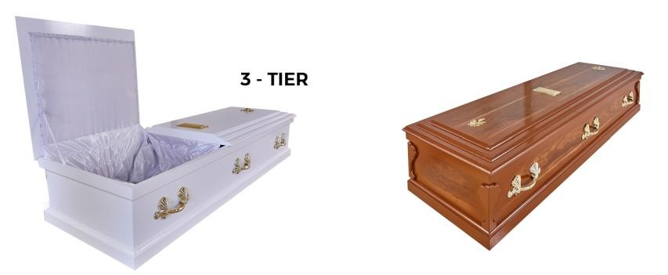

CLASSIC PACKAGE
Public
CASKET:
3 TIER
GROCERY BENEFIT
$250
HEARSE:
TOYOTA HILUX
PREMIUM PER MEMBER (WITHOUT BUS) PREMIUM PER MEMBER (WITH BUS)
PREMIUM PER PARENT (WITHOUT BUS) PREMIUM PER PARENT (WITH BUS)
$1.17
$1.98
$1.43
$2.42

Slide 5
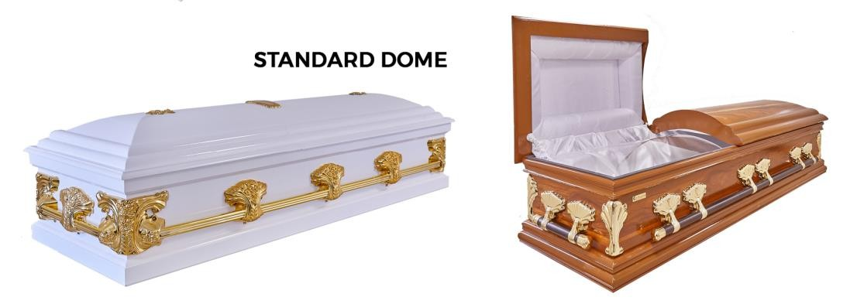

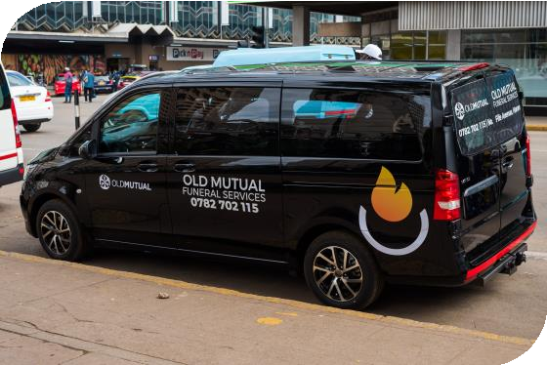
PREMIUM PACKAGE
Public
CASKET:
STANDARD DOME
GROCERY BENEFIT
$750
MOBILE TOILETS TENT & CHAIRS COURTESY VEHICLE
1 x VIP
100-SEATER
50KM RADIUS
HEARSE (RURAL)
HEARSE (LOCAL)
TOYOTA HILUX MERCEDES BENZ
PREMIUM PER MEMBER (WITHOUT BUS) PREMIUM PER MEMBER (WITH BUS)
PREMIUM PER PARENT (WITHOUT BUS) PREMIUM PER PARENT (WITH BUS)
$3.60
$4.41
$4.40
$5.59

Slide 6
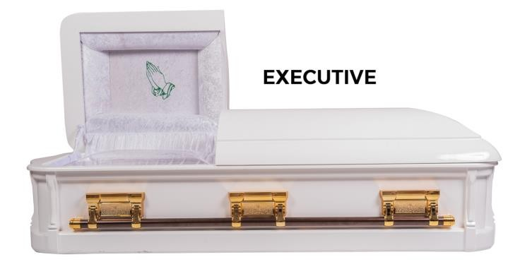

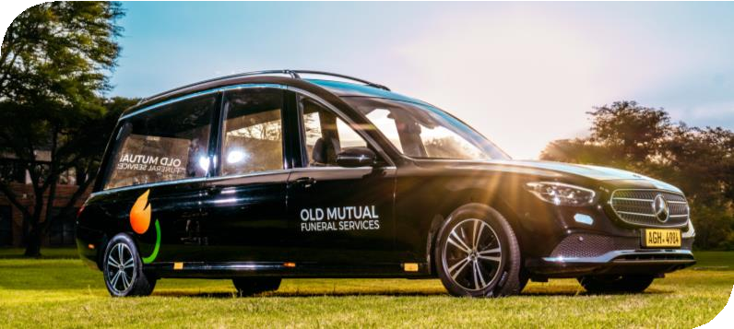
SUPREME PACKAGE
Public
CASKET:
EXECUTIVE DOME
GROCERY BENEFIT
$1000
MOBILE TOILETS TENT & CHAIRS COURTESY VEHICLE
1 x VIP
100-SEATER
50KM RADIUS
HEARSE
HEARSE (LOCAL)
TOYOTA HILUX MERCEDES BENZ
PREMIUM PER MEMBER (WITHOUT BUS) PREMIUM PER MEMBER (WITH BUS)
PREMIUM PER MEMBER (WITHOUT BUS) PREMIUM PER MEMBER (WITH BUS)
$4.77
$5.67
$5.83
$6.93

Slide 7
CASH IN LIEU OF SERVICE
Public
LITE PACKAGE
OPTION WITH A BUS $1470
OPTION WITHOUT A BUS $770
CLASSIC PACKAGE
OPTION WITH A BUS $1540
OPTION WITHOUT A BUS $910
PREMIUM PACKAGE
OPTION WITH A BUS $3430
OPTION WITHOUT A BUS $2800
SUPREME PACKAGE
OPTION WITH A BUS $4410
OPTION WITHOUT A BUS $3710

Slide 8


CONTACTS:
SIMBARASHE MAROVA. SAMANTHA NCUBE
+263782377155. +236775519541
+263 (292) 882251. +263 (292) 882251
SimbarasheMar@oldmutual,co.zw. SamathaN@oldmutual.co.zw
Public

