Slide 1

PUBLIC SERVICE COMMISSION & WORKER REPRESENTATIVES WORKSHOP
JUNE 2025
Committed to Care

Slide 2

The main objective of PSMAS is ensuring Universal Card Acceptance for its members as a means towards Universal Health Coverage (UHC).
UHC : provide all people with access to needed health services of sufficient quality to be effective and to ensure that the use of these services does not expose the user to financial hardship’ (World Health Report 2010)
BACKGROUND

Slide 3
KEY PILLARS
PSMAS exists to ensure that Government employees and their beneficiaries do access healthcare characterized by
Adequate Financial Protection
Reduce or eliminate Out Of Pocket payments.
Reliable card acceptance
Quality
Improve Health Outcomes (Reduce Mortality and Improve life Expectancy)
Reliable service delivery (Turn around times , prescription fill rates etc.)
Equity
Wide distribution of healthcare facilities (ease of access)
Ensure access based on need

Slide 4
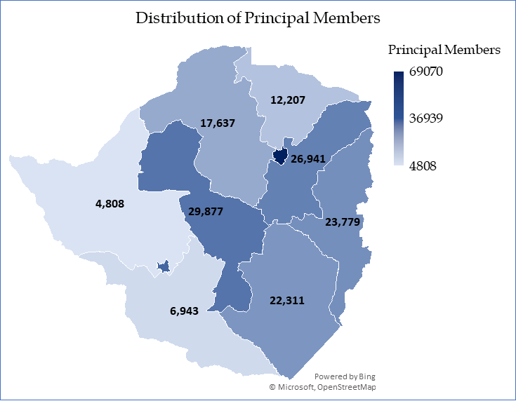
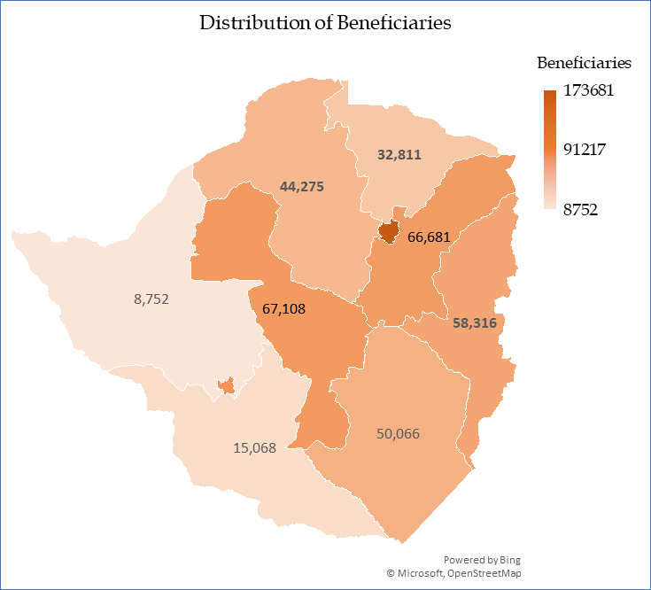

Slide 8
PUBLIC SECTOR CONTRIBUTIONS

Slide 11
Note: Cost per member (considering the whole membership per product)

Slide 12
Note: Cost per member claiming (per product)

Slide 13
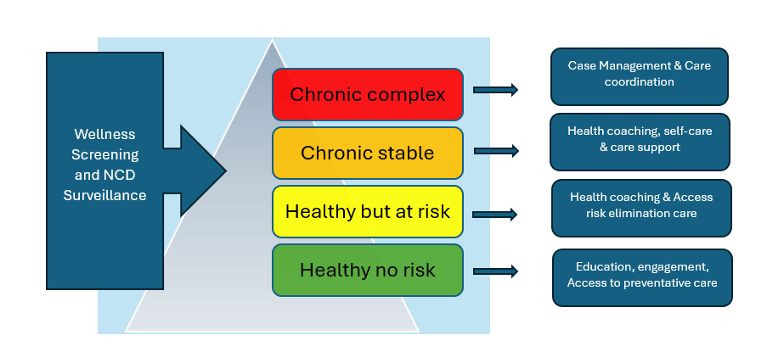
HEALTHCARE NEEDS
How we purchase healthcare is dependent on our understanding of healthcare needs for our members.
Through health risk profiling and claims analytics we have a thorough understanding of member needs.
Due to resource constraints (economics of healthcare) we need to make informed decisions on priorities (priority setting)

Slide 14
HEALTHCARE SERVICE PROVIDER NETWORK

Slide 16
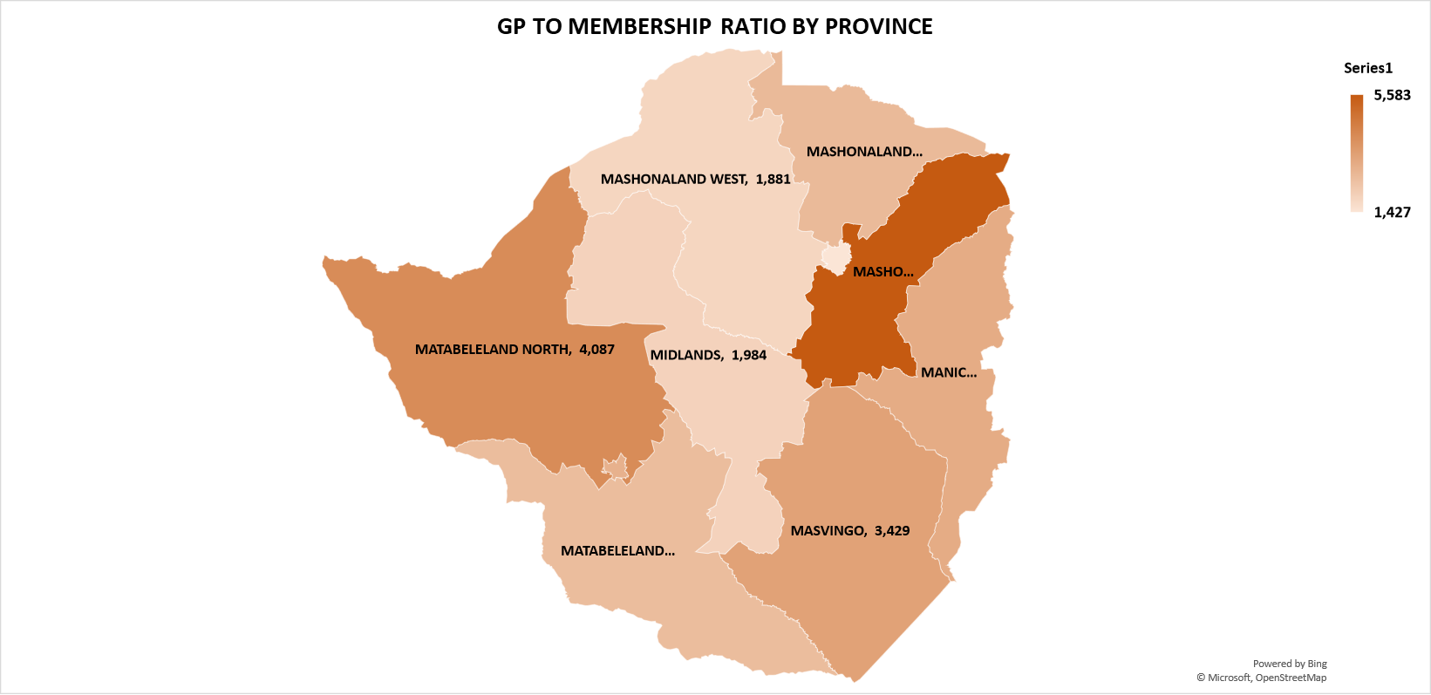

Slide 17
PROVINCE | GP - TO - MEMBERSHIP RATIO | PHARMACY - TO - MEMBERSHIP RATIO | SPECIALIST - TO - MEMBERSHIP RATIO
HARARE | 1,427 | 2,652 | 1,246
MIDLANDS | 1,984 | 5,733 | 5,159
MASHONALAND EAST | 5,583 | 9,135 | 33,496
BULAWAYO | 2,968 | 16,322 | 3,627
MANICALAND | 3,141 | 10,993 | 8,794
MASVINGO | 3,429 | 12,573 | 18,860
MASHONALAND WEST | 1,881 | 4,389 | 16,458
MASHONALAND CENTRAL | 2,709 | 5,756 | 6,578
MATABELELAND SOUTH | 2,635 | 5,928 | 23,712
MATABELELAND NORTH | 4,087 | 16,346 | -

Slide 18
HEALTHCARE UTILIZATION

Slide 23
HEALTHCARE INITIATIVES

Slide 24
WELLNESS AND PREVENTATIVE CARE
JAN-MAY 2025
4147 members screened had annual screening.
820 screened for Cervical cancer.
800 screened for Prostate cancer.
910 screened for breast cancer.
583 members in diabetes care program.
Conducted wellness programs with 24 public sector organisations.
Outreaches conducted in 15 cities and towns.

Slide 25
HEALTH RISK PROFILE ANALYSIS
All who retained positive results where referred for post screening care.
Follow up and support is being given to members to ensure they get timely post screening care.
Members with obesity & physical inactivity where enrolled into care programs.
Low uptake of screening:
  66% had no history previous breast cancer screening,
  75% had no previous cervical cancer screening and
  92% had no previous prostate cancer screening done.
Obesity 61.8% (higher in women than men at 3:1 ratio).
Physical inactivity 41.5%
Prediabetes 27%
Tobacco use 7%

Slide 26
MEMBER DISEASE PROFILE

Slide 27
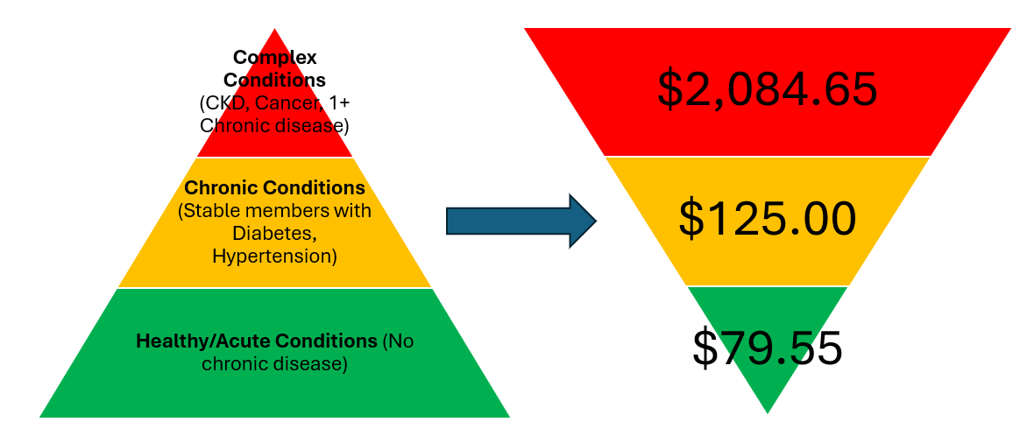
Member disease profile
20% of membership have at least 1 NCD disease.
All 152 CKD members have comorbid NCDs (HPT 82.8%, DM (14.4%)
  25 new CKD cases with 5 deaths during the period.
Top 5 cancers account for 75% of cancers amongst members: Breast, Prostate, Cervical, Colorectal & lung (in order).
Cost per member is exponentially higher for members with complex conditions.

Slide 28
STRATEGIC PURCHASING INITIATIVES

Slide 29

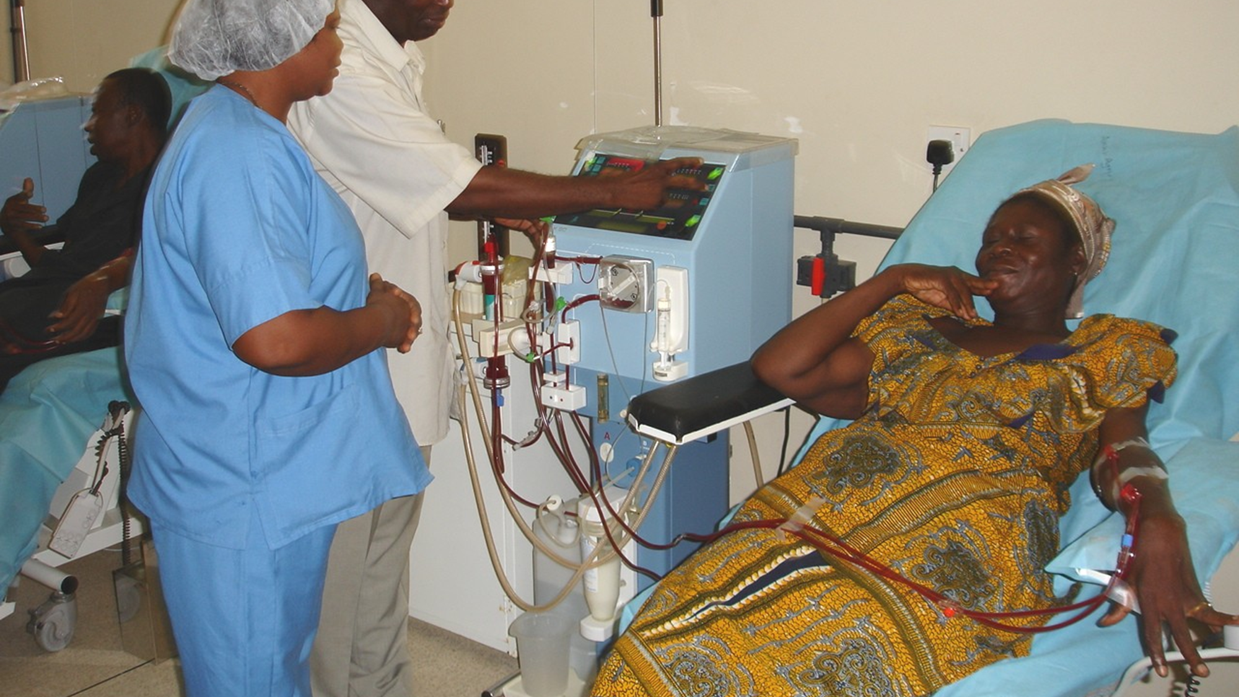
Through the strategic purchasing arrangements, the Society is currently contracting 14 Dialysis centres across the country to cater for the approximately 160 dialysis members since May 2024.
This reduced Mortality : When compared to 2024, which had on average 3 deaths per month and 2023 which was an average of 4 deaths per month.
Cost savings : When strategically purchasing in USD the Society is generating savings of US$108 000 per month which are lower than when purchasing in local

Slide 30

ACCESS TO MEDICINES
The facility was rolled out through Chain Pharmacies with presence in multiple provinces across the country (42 retail outlets across the country).
+20 000 members are accessing medicines through participating outlets.
Members are not paying any shortfalls
Facility now being rolled out to underserved areas
Cost savings due to negotiated mark-up

Slide 31
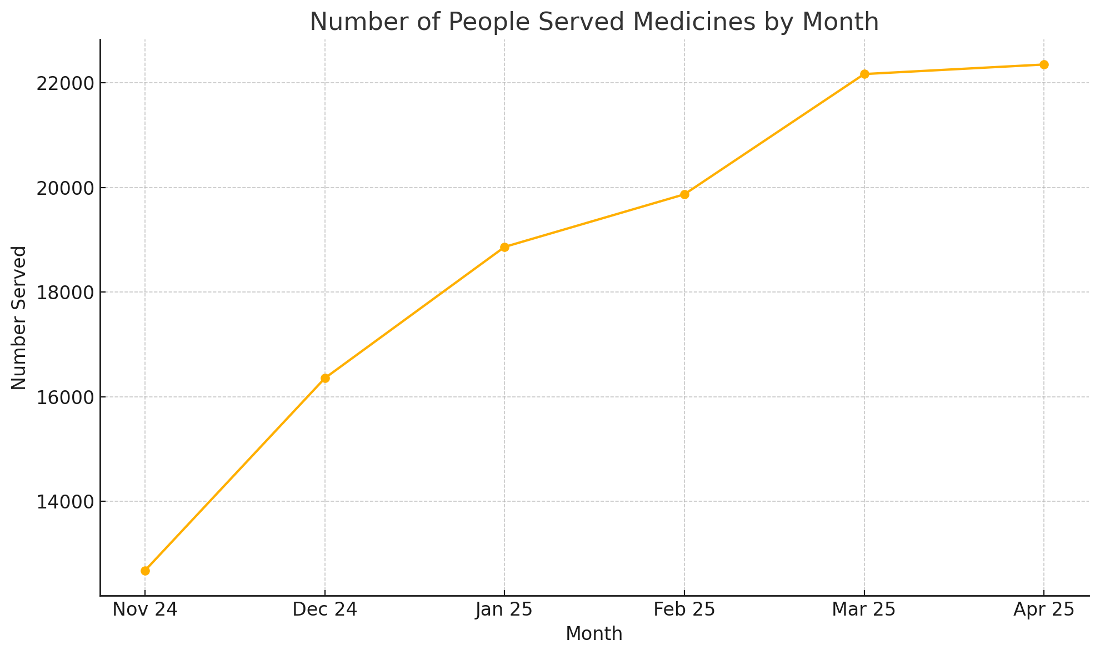

Slide 32
CHALLENGES & AREAS OF IMPROVEMENT
Financial sustainability
Healthcare access gaps & Quality issues
Operational efficiencies
External Factors
Claims Management
Stakeholder Communication
Liquidity crunch
Regulatory changes (NHI)
Healthcare inflation
Subscription adequacy

Slide 33
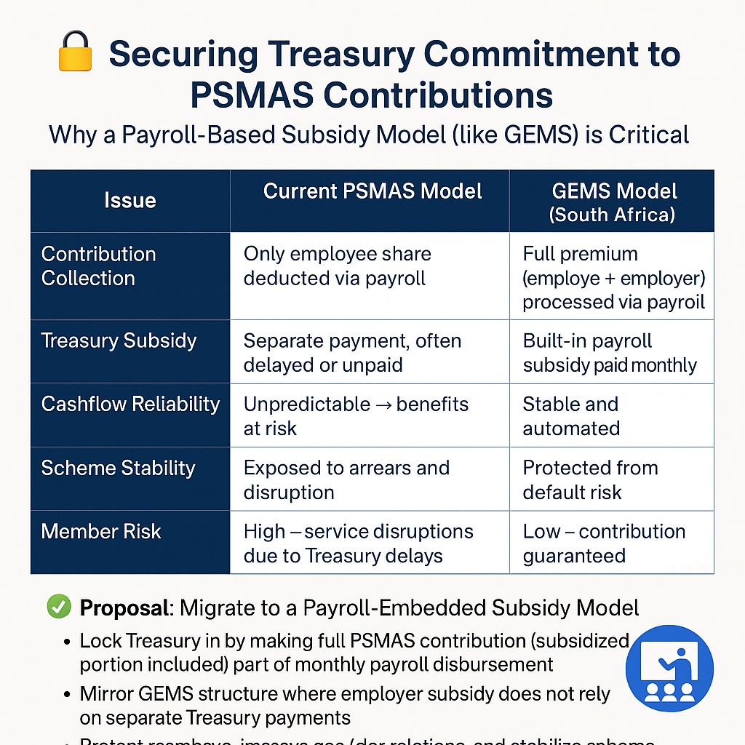
REGIONAL BENCHMARKING

Slide 34
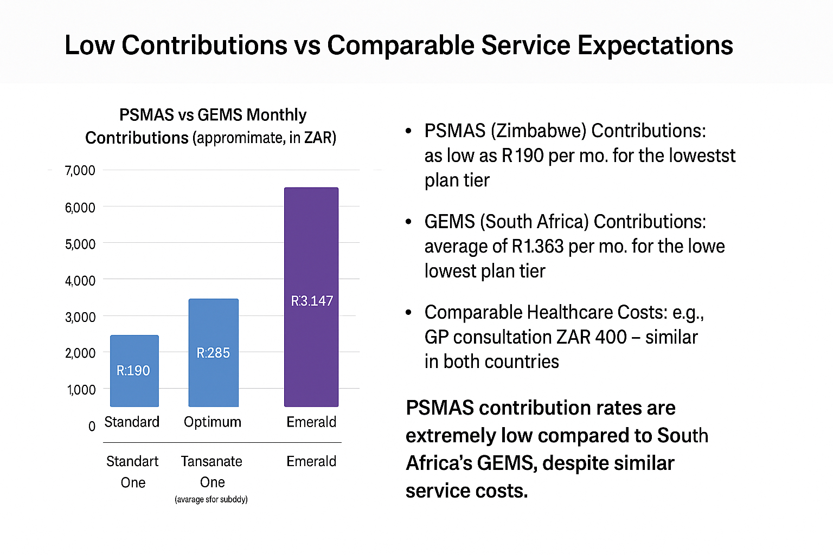
REGIONAL BENCHMARKING

Slide 35
WAY FORWARD
Reliable and Consistent Funding Model: Adequate funding Timeous funding
Specialists Access Program :Decentralize specialists services to Districts and Provinces and eliminate shortfalls (Collaboration with Health Service Commission)
Collaboration with Government : Strengthening collaboration with the Government for better healthcare funding to enhance member benefits
Sustainability initiatives Plans for ensuring long term sustainability of the Society through strategic investments , cost management and risk mitigation

Slide 36
WAY FORWARD
Consolidate current initiatives : Strategic purchasing of medicines , dialysis & oncology.
Expansion of Wellness Program : Collaboration with Government MDAs to increase uptake and support a sustainable implementation in the workplace and community
Leveraging on Digital health through upscaling of Telemedicine facility (increased member awareness)

Slide 37

STAY CONNECTED
Contact Centre
08688002635
WhatsApp
0783 183 30
Email
contactus@psmas.co.zw
X
@psmaszim
Facebook
PSMAS Zimbabwe
LinkedIn
PSMAS Zimbabwe
Service Provider Link
https://bit.ly/psmasproviderslist

