Slide 1


PUBLIC SERVICE COMMISSION
SALARY SERVICE BUREAU

Slide 2

PRESENTATION OUTLINE
Feedback from 2024 4TH Quarter Assignment
Integrated Modern Payroll And Pension System (IMPPS)
E-payslip

Slide 3
FEEDBACK FROM 2024 4TH QUARTER ASSIGNMENT
The Office was tasked to conduct intensive awareness campaigns on addressing payroll related issue:
Groups Engaged:
Assurance companies
Goods and service providers
Chief Directors and Directors Finance, IT, and HR of MDAs

Slide 4
ISSUES DISCUSSED
Payment of Salaries and Allowances-Ensure timely salary disbursement to all public sector employees
Collection and Remittance of Deductions-manages compulsory and voluntary deduction accurately
Production and Dispatch of Pay sheets and Wage Bills-creates and distributes essential payroll documents
Notification of Retirees- advise the due to retire in time, so that employees prepare the transition to be a pensioner
Dispatching Pension Termination Forms-coordinate with the pension department for benefits processing
Updating of Payroll Database-

Slide 5
INTEGRATED MODERN PAYROLL and pension system (impps)
the Public Service Commission is currently developing the Integrated Modern Payroll and Pension System (IMPPS) to automate and modernize the administration of the payroll and pension systems.
The project commenced on the 3rd of September 2024, and was intended to have two releases :
the E-Payslip and
the Payroll and Pensions management system

Slide 6
E-PAYSLIP
The e-Payslip was pilot tested in the Public Service Commission Secretariat on 28 February 2025.
The next phase of the pilot is to roll out a pilot test to Tripartite members and then to the rest of the Civil Service.

Slide 7
ACCESSING THE E-PAYSLIP
Members of the Civil Service will access the
e-Payslip through three channels:
Self-service portal -Uniform Resource Locator (URL) pscdemo.co.zw (EC number and a secure password required to log in)
b) Email- to be provided by Government-(mail.psc.org.zw)
c) WhatsApp-Employees providing whatsApp numbers
An empowered public service leading and propelling sustainable and inclusive socio-economic
growth and prosperity for all citizens of Zimbabwe

Slide 8
IMPPS PAYSLIP EMPLOYEE USER GUIDE
Employee- Self Service PortaL

Slide 9
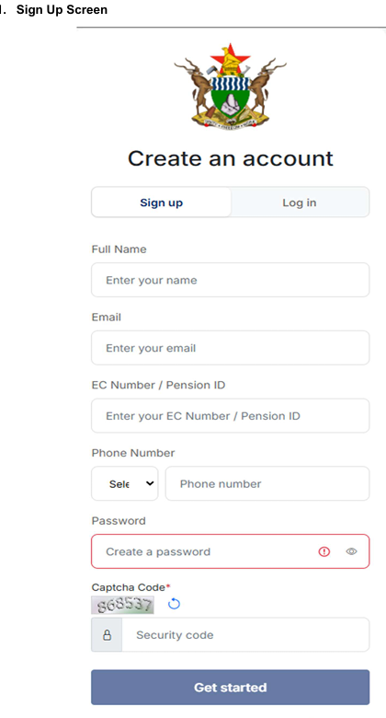

Slide 10
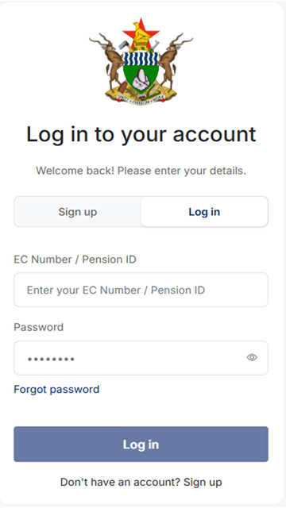
● The following details must be entered exactly as they appear in the database:.
❖ Full Name.
❖ Email Address.
❖ EC Number.
❖ Phone Number.
● Create Password.
2. Login Screen
● User can login using the url: https://pscdemo.co.zw

Slide 11
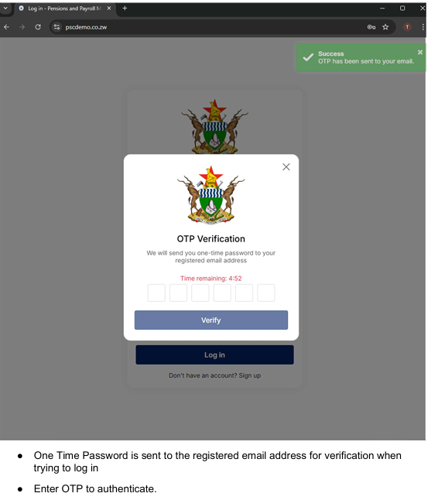
Username: EC Number.
● Password: User created Password.
3. OTP Verification

Slide 12
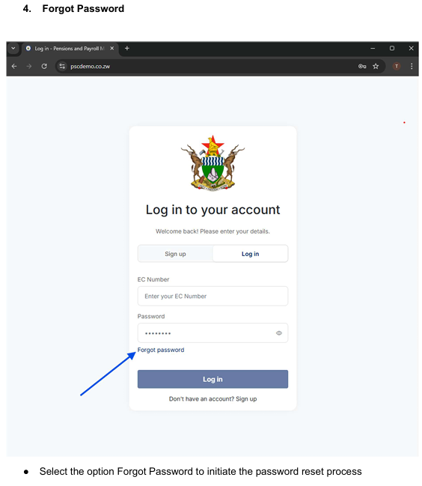

Slide 13
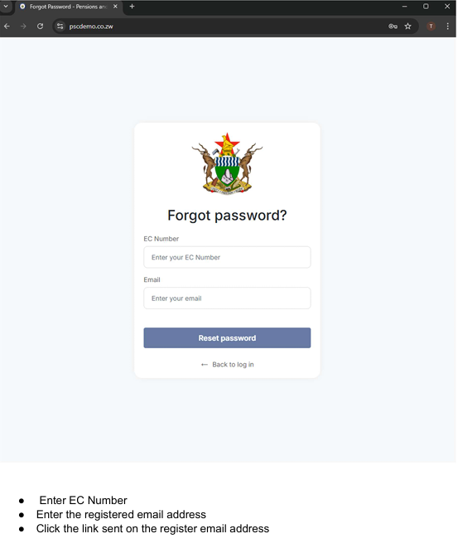

Slide 14
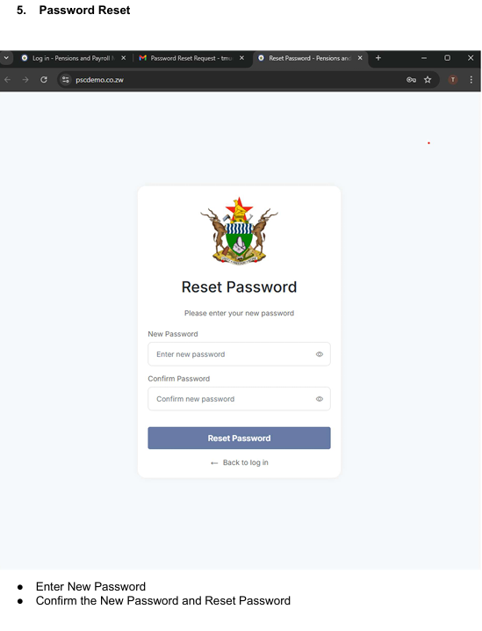

Slide 15
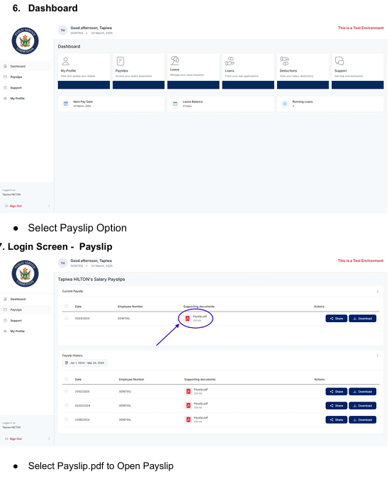

Slide 16
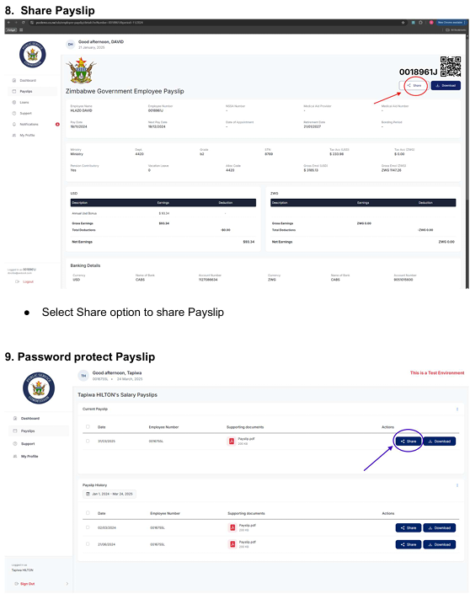

Slide 17
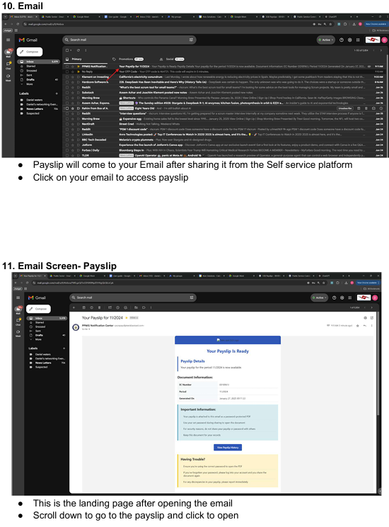

Slide 19
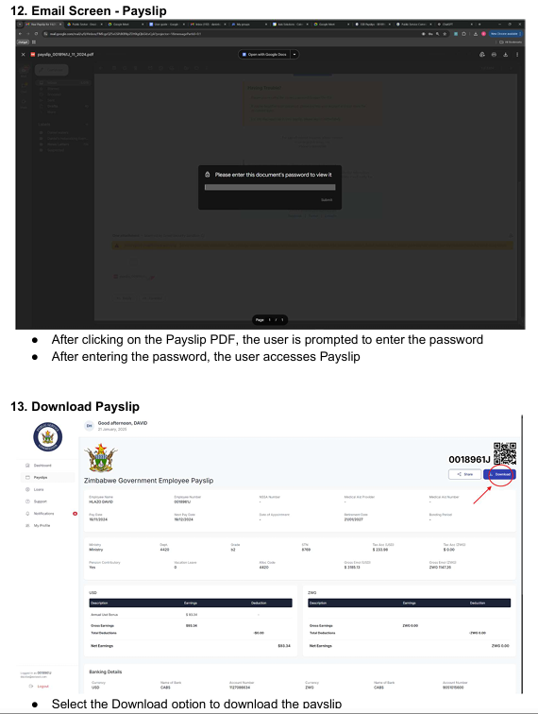

Slide 20
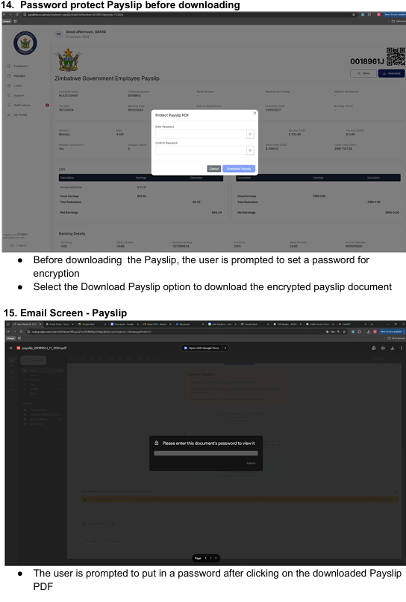

Slide 21
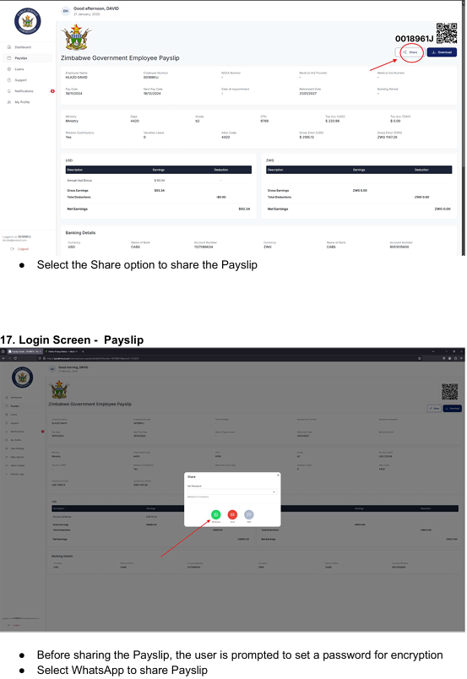

Slide 22
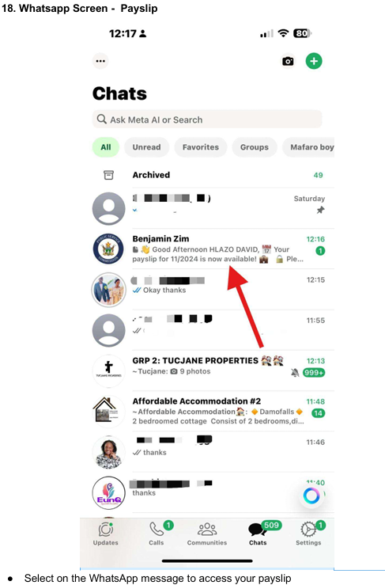

Slide 23
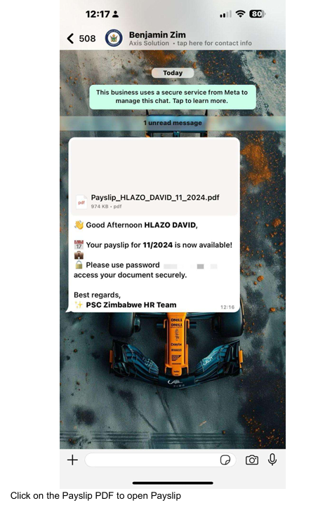

Slide 24
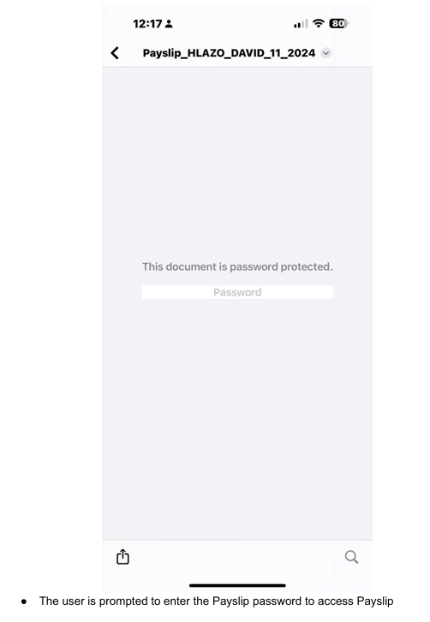
20. Whatsapp Screen - Payslip

Slide 25
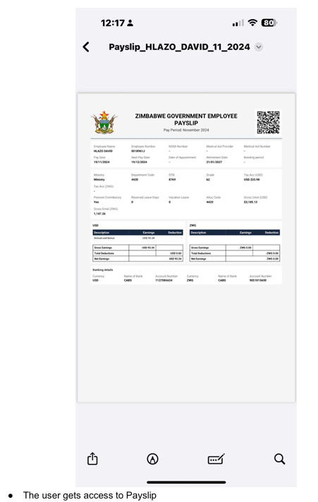
21. Whatsapp Screen - Payslip

Slide 26
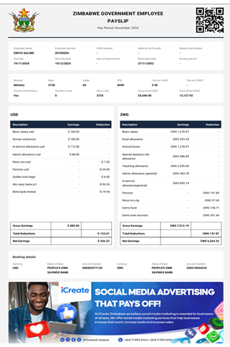
22. Payslip Summary

Slide 27
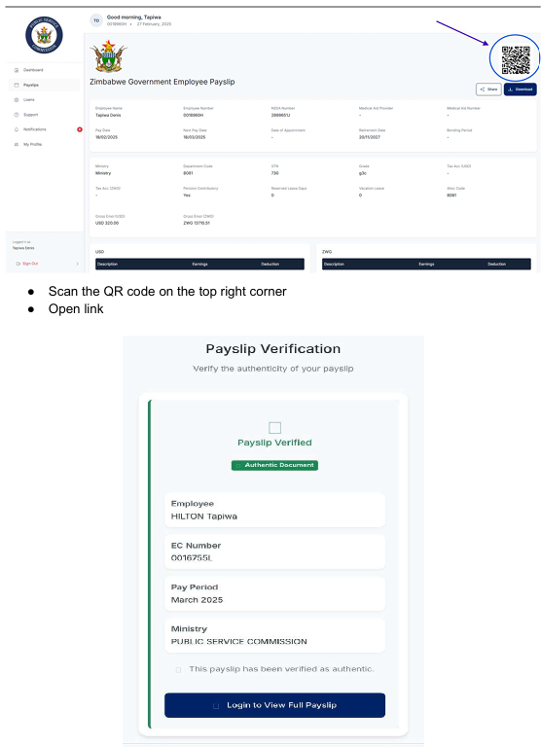
23. Qr Code Authentification

Slide 28
SECURITY OF THE E-PAYSLIP
The e-Payslip system uses advanced security measures to protect personal information.
The security features on e-Payslip are :
An OTP when one logs and expires in five minutes.
Session Expiration- If a user steps away from their device without logging out, a timeout ensures that no unauthorized person can access their account or sensitive data.
Passwords are required to open a downloaded payslip.
QR code for authentication.

Slide 29
SECURITY OF THE E-PAYSLIP
To improve security against malicious files, data penetration, viruses and hacking the system is designed with;
firewalls to protect data and
access is strictly restricted to system administrators within PSC.

Slide 30
ACTIONS TO BE TAKEN by payroll stakeholders
Organisations dealing with SSB must assess their digital readiness to support this transition.
Identify and appoint Change Agents and Change Champions to help detect applicable impacts whilst championing the organisational alignment. They will also provide information and coach other members throughout the change process.

Slide 31
CONCLUDING REMARKS
Organisations are encouraged to embrace this new technology , identify opportunities to be availed by the system.
The new payroll system will enhance the efficiency of the government payroll system, ensuring more timely and accurate compensation for employees while improving overall management and integrity of payroll processes.

Slide 32
LETS US HAVE YOUR
CONTRIBUTIONS TOWARDS THE DEVELOPMENT OF IMPPS GIVEN YOUR EXPERIENCE WITH THE LEGACY SYSTEM

Slide 33

THANK YOU

