Slide 1

MINISTRY OF NATIONAL HOUSING
AND SOCIAL AMENITIES
Report from the Housing Joint Committee
Presented at the 1st Quarter Consultative Workshop
Presented by the Chairperson of the Housing Joint Committee Chief Director : K.Rimai
1st April 2025

Slide 2

PRESENTATION OUTLINE
Introduction
Highlights :-Demand side of housing
-Stocks of GPP, NHF and Institutional Properties
-GPPs under construction
-Dilapidated properties
-The National Housing Allocation Policy
-The Zimbabwe National Human Settlements Policy
3. Concept note for civil service housing program
4. Conclusion
MINISTRY OF NATIONAL HOUSING
AND SOCIAL AMENITIES

Slide 3

Introduction
During the last consultative workshop, the Public Service Property Ownership Joint Committee was tasked look into the following tasks;
Review the proposed committee terms of reference
To come up with a time framed roadmap on property initiatives for civil servants
Develop a concept note on property ownership initiatives for civil servants
The purpose of the National Joint Negotiating Housing Committee is to assist the National Joint Negotiating Committee (NJNC) in fulfilling its obligations and responsibilities with respect to delivery of affordable properties to the Civil Service Employees.
Its members include workers representatives from Zimbabwe Confederation of Public Service Trade Unions and MDAs that include PSC, MPSLSW, MNHSA, MLGPW, MLAFRWD, NBS.
Terms of Reference
MINISTRY OF NATIONAL HOUSING
AND SOCIAL AMENITIES

Slide 4
To undertake research on areas of property investments and needs of the civil servants as assigned by the NJNC.
Assess each potential property investment business case and recommend implementation strategies.
To review a comprehensive database for Civil Servants members awaiting allocation of State land and properties.
To engage responsible MDAs in identifying land banks for developing low-cost properties for the Civil Service Employees.
Keep track on implementation decision of the National Joint Negotiating Council on Property investment issues to achieve non-monetary compensation to intended beneficiaries.
Propose and recommend policy changes in relation to the Human Settlement Policy and related policies.
To propose and recommend partnerships with landowners and developers, including private developers and local authorities who are providing affordable properties development throughout the country.
Assess, review and recommend projects budget to NJNC for approval.
Summary of the objectives of the committee
MINISTRY OF NATIONAL HOUSING
AND SOCIAL AMENITIES

Slide 5
HOUSING DELIVERY GAP
Statistics from the recent NDS 1 Housing Delivery Report show that 40% of housing projects are being funded and implemented by Local Authorities, 26% by Banks, 23% by Private Developers and 11% by Treasury.
Questions to ask ourselves:
Which opportunities can we explore for low cost housing?
Which models can we employ? How do we come up with models that benefit the civil service sector and create packages for this group and how can we remodel rent to buy models to enable housing access by the majority of home seekers?
TREASURY
11%
LOCAL AUTHORITIES
40%
PRIVATE DEVELOPERS
23%
MINISTRY OF NATIONAL HOUSING
AND SOCIAL AMENITIES

Slide 6
Demand side of housing
There are 7,748 Government Pool Properties nationwide, 348 houses are inhabitable.
The table below outlines the breakdown of these properties by province:
 | PROVINCE | NUMBER OF HOUSES | INHABITABLE HOUSES | HABITABLE HOUSES | (%) UNHABITABLE
1 | Manicaland | 1183 | 14 | 1169 | 1.2
2 | Masvingo | 1066 | 94 | 972 | 8.8
3 | Mashonaland East | 997 | 63 | 934 | 6.3
4 | Mashonaland West | 952 | 23 | 929 | 2.4
5 | Mashonaland Central | 633 | 35 | 598 | 5.5
6 | Matabeleland South | 979 | 9 | 970 | 0.9
7 | Matabeleland North | 800 | 17 | 783 | 2.1
8 | Midlands | 597 | 87 | 510 | 14.6
9 | Harare Metropolitan | 467 | 4 | 463 | 0.9
10 | Bulawayo metropolitan | 74 | 2 | 72 | 2.7
 | TOTAL | 7748 | 348 | 7400 | 4.49%
MINISTRY OF NATIONAL HOUSING
AND SOCIAL AMENITIES

Slide 7
Demand side of housing (cont’d)
There are 8,622 tenants occupying GPPs, and this means that some individuals are sharing accommodations due to a limited number of available properties since available GPPs are 7,748 .
To address this issue, it is recommended to prioritize the construction of additional housing units.
The committee identified that a total of 7 729 members are on the housing waiting list in all provinces – which is a low number not reflective of beneficiaries wishing to be considered.
The committee recommended that more efforts should be made to inform civil servants on how to register to be on the waiting list.
Requirements for Government rented accommodation/ or to register on the waiting list
The applicant must be at least 18 years old.
A certified National Identity Card is required.
Current payslip for civil servants or proof of employment for non-civil servants must be provided.
A recent bank statement is needed.
MINISTRY OF NATIONAL HOUSING
AND SOCIAL AMENITIES

Slide 8
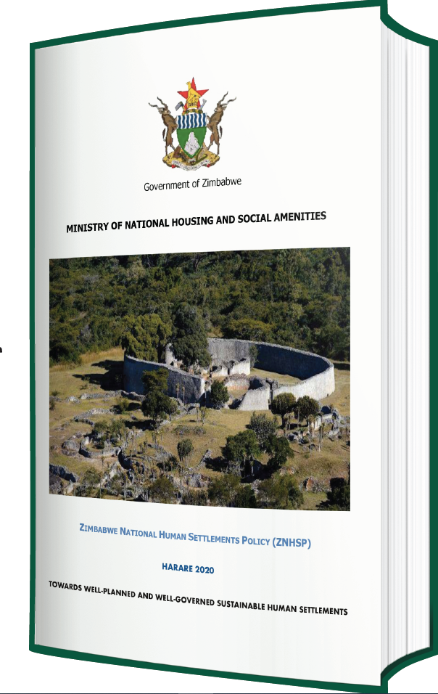
The Allocation Policy and the ZNHS Policy
The Housing Allocation policy
it aims to establish a framework to guide the allocation of housing units to civil servants by the MNHSA, to enhance good corporate governance and to promote transparent, equitable and fair access to government enabled housing units.
2. The Zimbabwe National Human Settlements Policy
Is a policy that is alive to sustainability, and advocates for:
Spatial planning and management of settlements
Offsite and onsite infrastructure
Densification
Rental housing
Regularisation of informal settlements
Displacements and relocations
Urban regeneration and renewal
Environment, climate change and new building technology
Land access and tenure

Slide 9
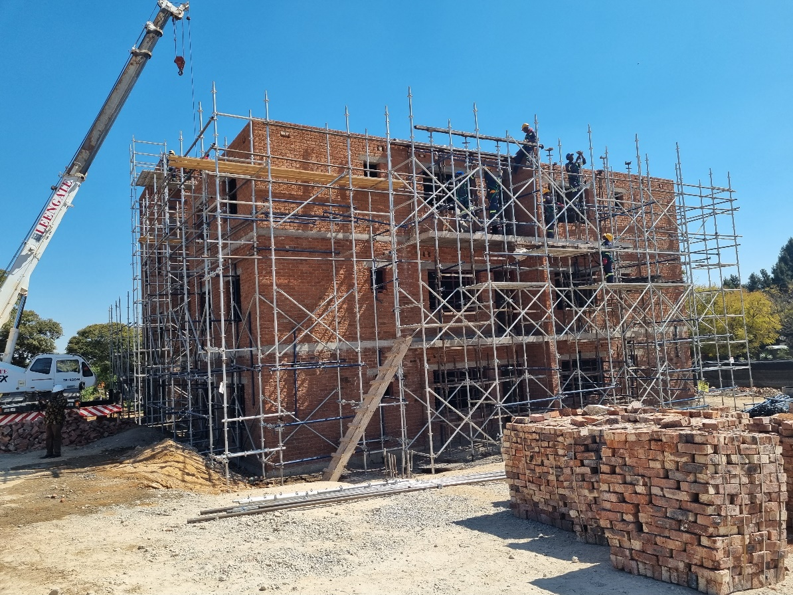
DENSIFICATION MODEL
The ZNHSP guides that it is now instructive that at least 40% of land for human settlements development must be reserved for the construction of flats.
The Ministry has been proactive on implementing the densification model in most of its construction sites which include: Dombotombo Walk up Flats in Marondera
Senga walk up flats in Gweru,
Dzivarasekwa walk up Flats in Harare
This is a clarion call to the built environment to ensure the application of the densification model in construction projects. And this also influences proposals for housing for civil servants, eg mix of stands and flats.
Construction works at Dombotombo – Marondera
MINISTRY OF NATIONAL HOUSING
AND SOCIAL AMENITIES

Slide 10
Ongoing projects for GPPs
Project name | Scope | Status | Budget
Beitbridge redevelopment | Construction of 2 blocks of garden flats and 2 blocks of double storey duplex flats (total 64 units) | progress is at 71% | Contract sum - US$7,500,000.00 Cost of outstanding works ZWG25,000,000.00
Marondera Dombotombo | Construction of 4x4 storey blocks of flats (2 bed roomed H-Type flats), with a total of 64 Housing units. | progress is at 90% | Contract sum - US$3,279,580.40 Cost of outstanding works ZWG75,000,000.00
Mutawatawa UMP blocks of flats | Construction of 4x4 storey blocks of flats (2 bed roomed H-Type flats), with a total of 64 Housing units. | progress is at 25% | Contract sum - US$4,800,000.00 Cost of outstanding works ZWG100,000,000.00
Senga Messengers Camp, Gweru | Construction of 4x4 storey blocks of flats (2 bed roomed H-Type flats), with a total of 64 Housing units. | progress is at 43% | Contract sum - US$4,556,794.71 Cost of outstanding works ZWG43,750,000.00
Zambezi Flats, Harare | Construction of 4x4 storey blocks of flats (3 bed roomed with a total of 32 units) | progress is at 5% | Contract sum - US$5,668,625.91 Cost of outstanding works ZWG141,715,650.00
MINISTRY OF NATIONAL HOUSING
AND SOCIAL AMENITIES

Slide 11
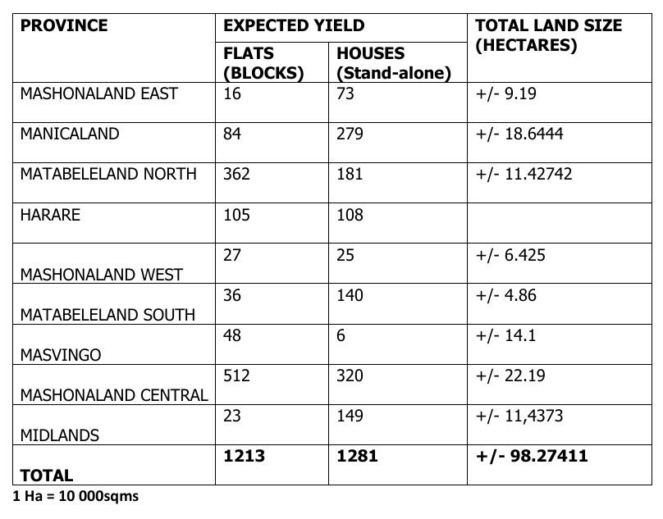
Stocks of existing land banks
MINISTRY OF NATIONAL HOUSING
AND SOCIAL AMENITIES

Slide 12
Concept Note: The proposed civil service housing program (CSHP)
CSHP seeks to improve access to affordable housing by civil servants through homeownership, and government rental properties including regeneration of dilapidated government pool properties.
The proposal is that 70% properties delivered by the CSHP will be for homeownership whilst 30% will be for government rental purposes.
The program proposes to utilize various pieces of land accessible to the MNHSA which were identified across the country (+/_98ha).
Some of these pieces of land have existing GPPs sitting on large tracts of underutilized land while other GPPs are in a state of dilapidation and are unsuitable for human habitation. It is proposed that such houses be demolished and replaced with modern units which provide dignity to civil servants.
The CSHP also proposes purchase of stands / serviced land already available on the market for the benefit of civil servants on flexible payment terms.
The CSHP for now proposed initiatives on residential property ownership, and it is envisaged that commercial and agro-residential properties will considered later.
MINISTRY OF NATIONAL HOUSING
AND SOCIAL AMENITIES

Slide 13
Concept Note: The proposed civil service housing program CSHP
Item | Remarks
Implementing Agency | Government of Zimbabwe
Target Market | Civil Servants
Coverage | Countrywide
Land Size | +/-70 hectares
Number of Expected Units | +/-5 303 units
Estimated Cost | USD226Million
Scope | Delivery of stands, flats, cluster houses, model rural/ agro residentials and social amenities.
Programme Duration | +/_3 years
Source of Funding | Government/Private Sector
MINISTRY OF NATIONAL HOUSING
AND SOCIAL AMENITIES

Slide 14
Recommendations
Conducting site visits to assess the availability of land and sizes, and determine the feasibility of infrastructure development on these sites.
PSC to conduct a survey to gather current housing demand by civil servants.
Benchmark housing designs against international best practices through desk research or engaging foreign companies implementing the same projects.
Adopt cost reduction strategies to make housing more affordable for civil servants, for instance construction of shell structures with brick finishes.
Structure flexible payment terms for favorable deposits, monthly payments and tenure.
Implement a Hybrid delivery model that leverages the strengths of both public and private sector involvement.
Broaden the scope of the housing program to include the provision of essential social amenities, residential stands (urban and rural), and agro-residential stands.
Explore alternative technology which uses locally available resources.
Explore available units or stands on the market for inclusion into the CSHP for the benefit of civil servants.
Exploring PPPs to enhance housing delivery for civil servants.
Approval and adoption of the concept note for CSHP.
MINISTRY OF NATIONAL HOUSING
AND SOCIAL AMENITIES

Slide 15
Road Map
Activities and Timelines towards Public Service Property Ownership
NO. | ACTIVITY | TIMELINE
1 | Land bank identification | 11 February 2025
2 | Property Ownership Draft concept note development | 15 March 2025
3 | Presentation of concept paper to the NJNC Consultative Committee | 01 April
4 | Site visits for land bank verification and feasibility | 25 April 2025- 23 May 2025
5 | Report on the findings from site visits | 12 June 2025
6 | Final concept note development | 2nd quarter 2025
8 | Presentation of concept paper and report to the NJNC Consultative Committee | 2nd quarter 2025
9 | Stakeholder Engagement: Resource mobilisation | 3rd quarter 2025
10 | Project launch | End of 3rd quarter 2025
MINISTRY OF NATIONAL HOUSING
AND SOCIAL AMENITIES

Slide 16


