Slide 1


Enhancing Workplace Safety and Health in Zimbabwe
The Joint Occupational Safety and Health Committee welcomes the august house to the second quarter consultative meeting. We will discuss our progress and next steps in drafting a road map for establishing an OSH policy for the Public Service.

Slide 2

Update on Implementation of Committee Directives
Bulawayo Meeting Outcomes
To Review Terms of Reference.
To Align OSH roadmap timelines.
To Estimate activity budget.
To Submit TOR to NJNC.

Slide 3

Key Definitions Established
Occupational Safety and Health (OSH)
A fundamental workplace right encompassing all health and safety aspects. Its goal is to prevent accidents and diseases.
National Joint Negotiating Council (NJNC)
A bipartite platform for collective bargaining. It negotiates public service conditions.
National Social Security Authority (NSSA)
A statutory body administering social security schemes. It provides employee benefits.
MDAs
Government Ministries, Departments, and Agencies. These are key implementation bodies.
Clear definitions are vital for shared understanding and consistent application of policies.

Slide 4
Strategic Roadmap in establishing an OSH Policy :
1
Establishment of a steering Committee to drive the Process (Completed)
2
Review of OSH applicable legislation, OSH standards and Best Practices (July-August 2025).
3
Needs Assessment (September-October 2025).
4
Drafting the OSH Policy Framework (November 2025-Janaury 2026)
5
Consultative Workshop on the Draft OSH Policy (February 2026).
6
Action Plan Development to implement the OSH Policy (March 2026).
7
OSH Policy Launch (May 2026).
8
Monitoring & Evaluation of the OSH Policy Implementation(March 2026).

Slide 5

Review of OSH applicable legislation, OSH standards and Best Practices
From July to August 2025, a thorough review of all applicable OSH legislation, standards, and best practices will be conducted. This includes :
the Factories & Works Act 14:08,
National OSH Policy,
Pneumoconiosis Act Chapter 15:08,
SI68 of 1990, and all ratified and unratified OSH Conventions

Slide 6

Needs Assessment
During September and October 2025, a comprehensive needs assessment will be undertaken to identify existing OSH practices within government ministries. This phase involves a detailed examination of current protocols, their effectiveness, and areas requiring improvement to inform the new policy.
Current Practices Examination
An in-depth audit will determine any existing OSH practices currently implemented across various government ministries, assessing their scope and impact.
Employee Consultation
Surveys and interviews will be conducted with employees to gather valuable input on their expectations for the OSH policy and identify any perceived gaps in current safety measures.

Slide 7





Draft OSH Policy Framework
From November 2025 to January 2026, the OSH Policy Framework will be drafted, incorporating all findings from the needs assessment and legal review. This phase is crucial for defining the policy's scope and operational guidelines.
Defining Objectives
Clearly articulating the primary goals and desired outcomes of the OSH policy for the Public Service.
Roles and Responsibilities
Outlining the specific duties and accountabilities of both employers and employees under the new policy.
Establishing Procedures
Detailing the operational procedures and protocols to be included in the policy, ensuring practical implementation.
Consultative Process
Integrating a consultative process, potentially through questionnaires, to ensure all stakeholder views are considered in the draft.

Slide 8

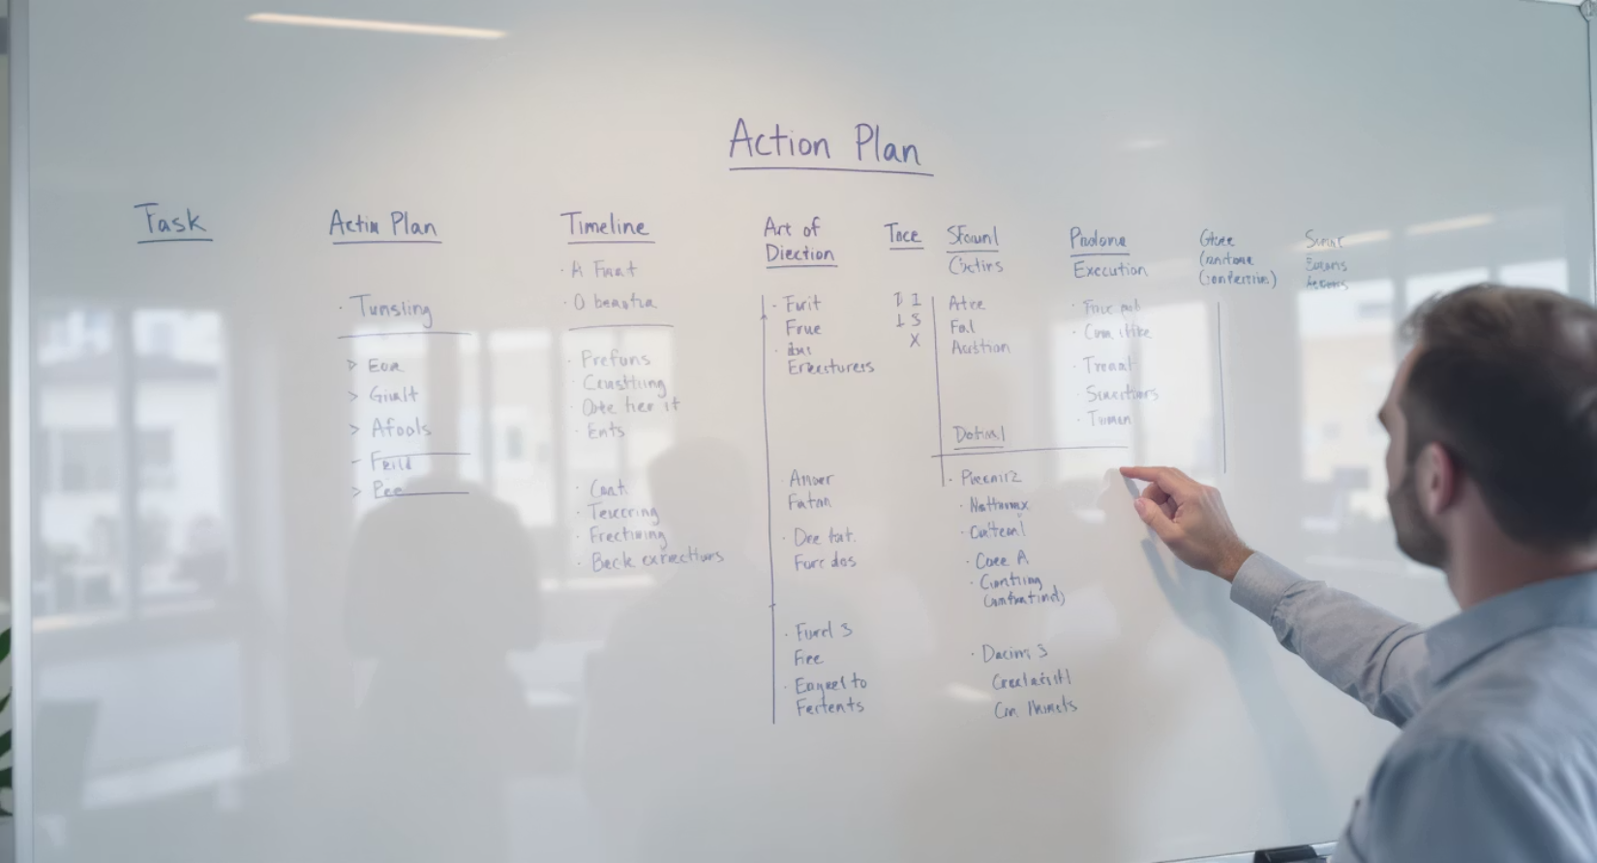
Consultative Workshop on the Draft OSH Policy
February 2026 will be dedicated to a crucial consultative workshop on the draft OSH Policy. This workshop provides a platform for government officials, employees, and relevant stakeholders to review the draft, offer feedback, and ensure the policy is robust and widely accepted.
Following the workshop, March 2026 will focus on the development of a detailed Action Plan for policy implementation. This plan will specify timelines, resource allocation, and responsibilities, translating the policy framework into actionable steps.

Slide 9
Finalization and Policy Launch
This phase marks the culmination of the policy development process, preparing the OSH Policy for its official release and adoption within the Public Service.
April 2026: Printing & Packaging
The final OSH policy document will undergo professional printing and packaging, ensuring a clear, accessible, and durable publication for all stakeholders.
1
2
May 2026: Official Launch
The OSH Policy will be formally launched in a public ceremony, signaling its official adoption and commitment to occupational safety and health across the Public Service.

Slide 10
Continuous Monitoring and Evaluation
The implementation of the OSH Policy in the Public Service is an ongoing commitment that requires continuous monitoring and evaluation. This phase ensures the policy remains effective, responsive, and relevant to the evolving needs of the public service workforce.
Performance Tracking
Compliance Audits
Regular collection and analysis of key OSH performance indicators, such as incident rates, training completion, and compliance adherence.
Periodic audits to verify adherence to established OSH procedures and regulatory requirements across all public service entities.
Policy Review & Updates
Feedback Mechanisms
Regular review of the policy to ensure it remains current with best practices, legislative changes, and emerging OSH challenges.
Establishing channels for employees and departments to provide feedback on policy effectiveness and identify areas for improvement.

Slide 11

Moving Forward Together
Next Steps
The immediate next step is to formalize the timelines for the needs assessment, ensuring all relevant data is collected to inform the policy drafting. Continued collaboration to ensure the successive implementation of the OSH Policy is highly recommended.
Our collective efforts will build a safer, healthier future for all public service employees.

